Slide 1
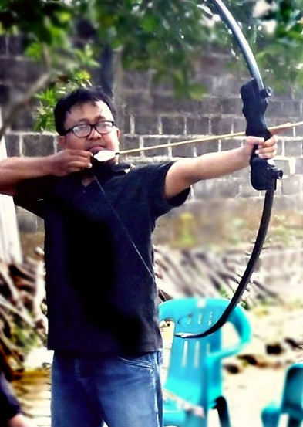

Dr. Kumara Ari Yuana, ST., MT.

Slide 2

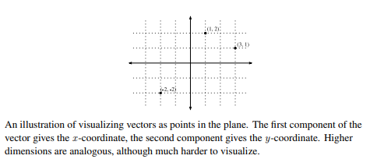

Slide 3
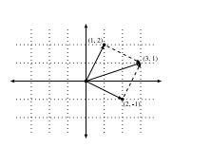
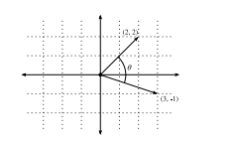

Vector addition and angle

Slide 4
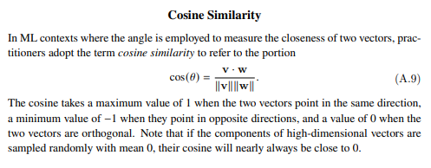

Slide 5
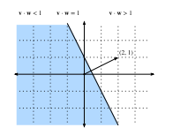
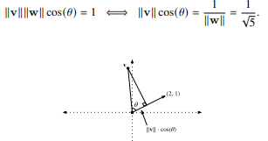
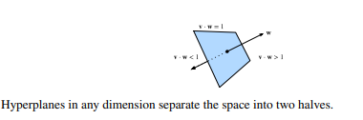
Hyperplanes

Slide 6
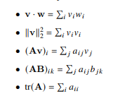
Tensors and Common Linear Algebra

Slide 7
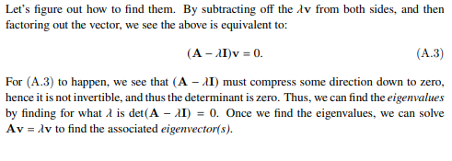
Eigen decompositions
Finding Eigenvalues

Slide 8



Rules of Calculus
Common Derivatives
Derivative Rules

Slide 9
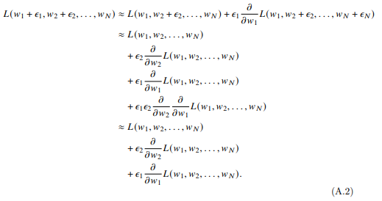
Multivariable Calculus
Higher-Dimensional Differentiation

Slide 10
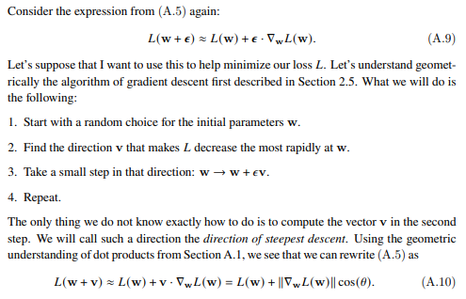
Geometry of Gradients and Gradient Descent

Slide 11
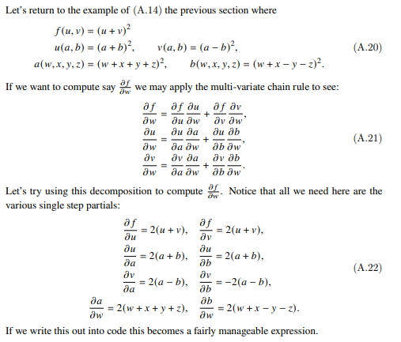
The Backpropagation Algorithm

Slide 12
More..
Integral Calculus
Maximum Likelihood
Distributions functions
Information Theory

